Slide 1
360° Engagement
Crafting a Seamless Brand Experience
Presented by Jennifer Couch

Slide 2
My Tidbits for Today
Personas and how they fit into a 360° experience
Full circle marketing: maximizing every touchpoint

Slide 3
Flip Your Persona Approach
Not just an ideal client profile

Slide 5
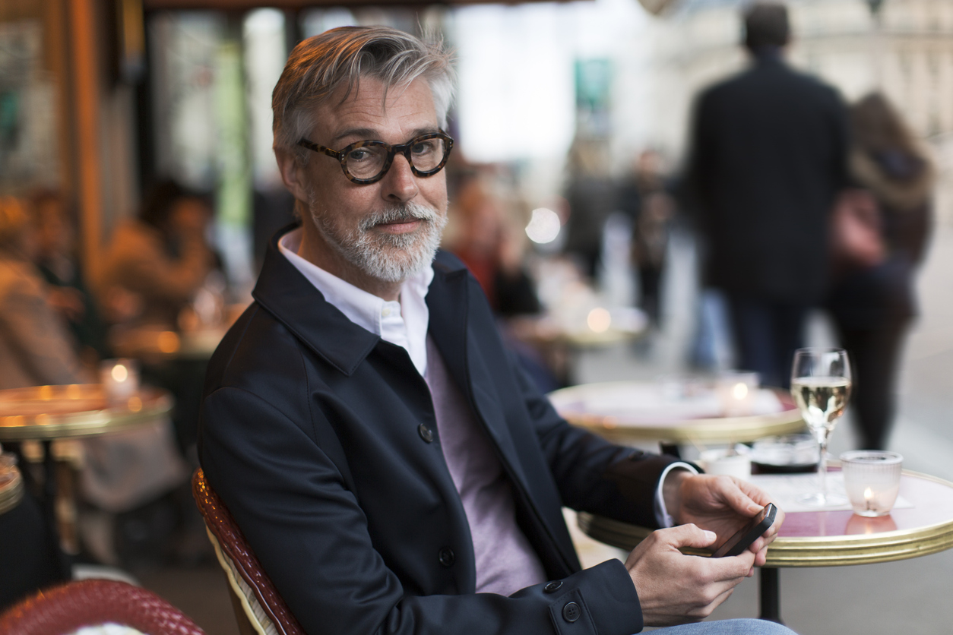
Ideal Brand Persona
Personality
Values
Reputation
Experience
Associations

Slide 6


Values
Client minded
Archetypes
Hero: Always looking for a challenge or opportunity to improve.
Strengths
Competent and disciplined
Challenges
Not likely to directly ask for referrals
Intellectually curious
Innovative and entrepreneurial
Focused and observant
Sage: Curios with desire to find the truth and understand details.
Caregiver: Desire to care for and nurture relationships with clients, protecting them from harm.
Thorough and resourceful
Trust and discretion, personalized approach
Approachable and communicative
Can over analyze or spend too much time in analysis
Challenge with showing vulnerability
Can struggle to set boundaries

Slide 7
Full Circle Marketing
Maximizing every touchpoint

Slide 8
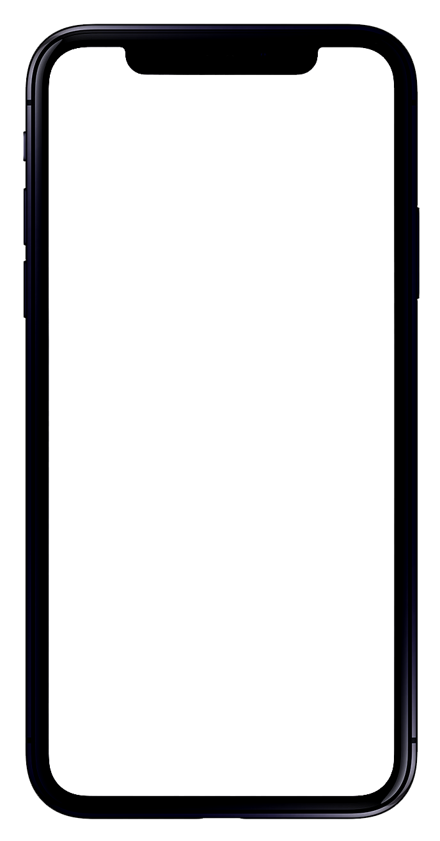
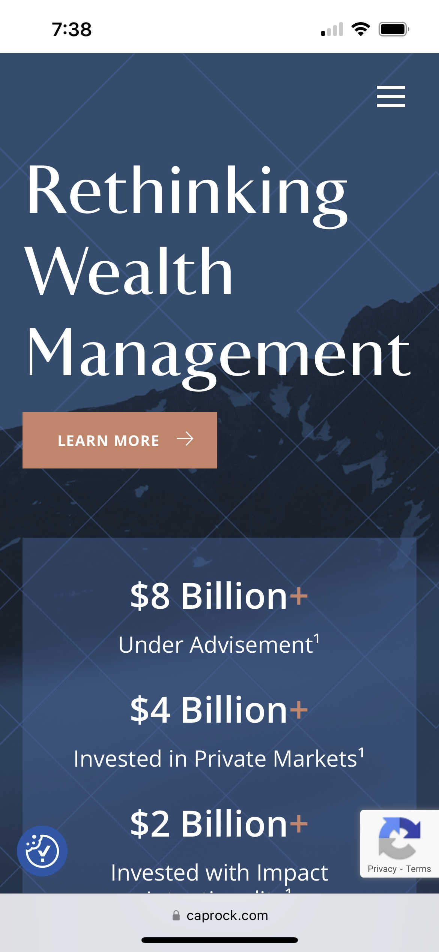
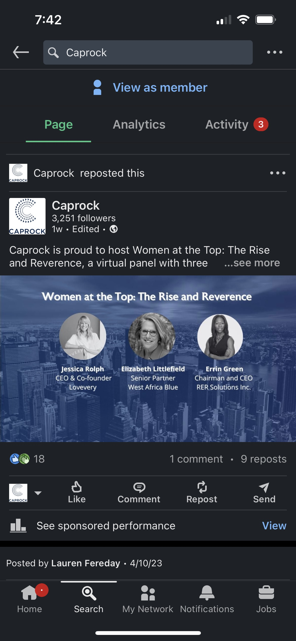
Digital & Traditional
Leverage social media
Invest in content marketing
Optimize your website
Drive email marketing
Paid digital ads
Participate and host events
Outdoor advertising
Direct mail
Earned and paid direct media
Sales and customer service

Slide 9

And their message…
Your message…
“Caprock came highly recommended when I was searching for a full-service financial firm. Since becoming a client, I would say my expectations have been exceeded. They are experts in private investments and very responsive to my needs.”
Sample, client testimonial

Slide 10

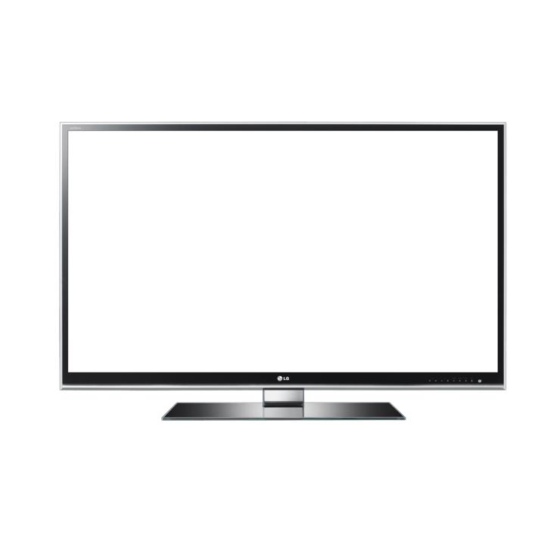
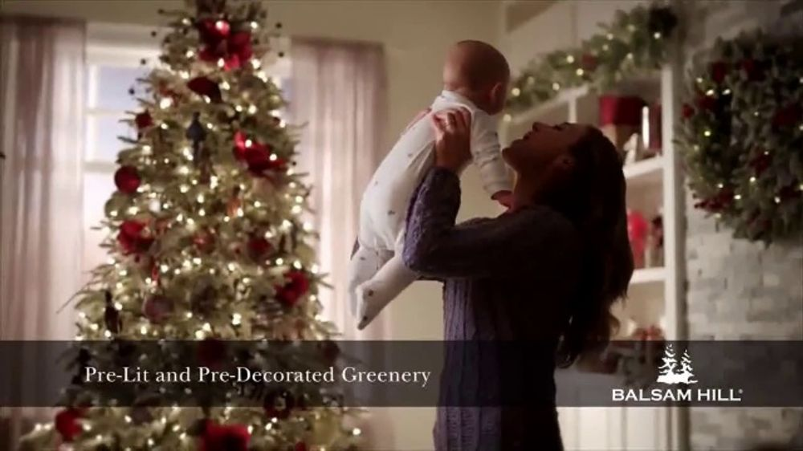


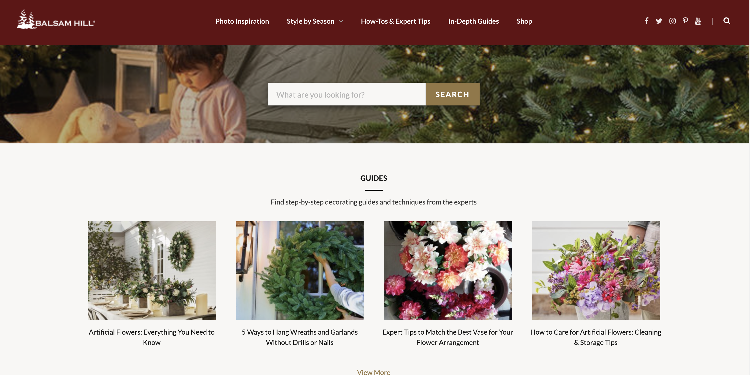
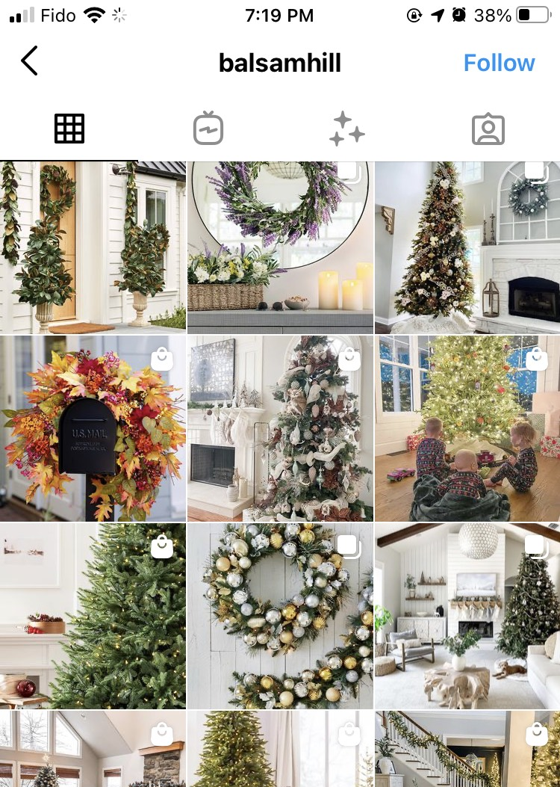

Sharing your story through a multi-channel approach
Touchpoint
4.26 UTPs/order
Print ads
TV
Mass Reach
Email prospecting
Consistency across platforms
Events
33%
Social Media
Digital ads
Community blogs
Targeted Reach
Connected TV
Revenue increase
Connect with consumers at the right time with the appropriate message

Slide 11
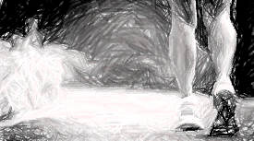
Evolve
&
Follow the Energy

