Slide 1
BUILDING A PASSION BRAND

Slide 2
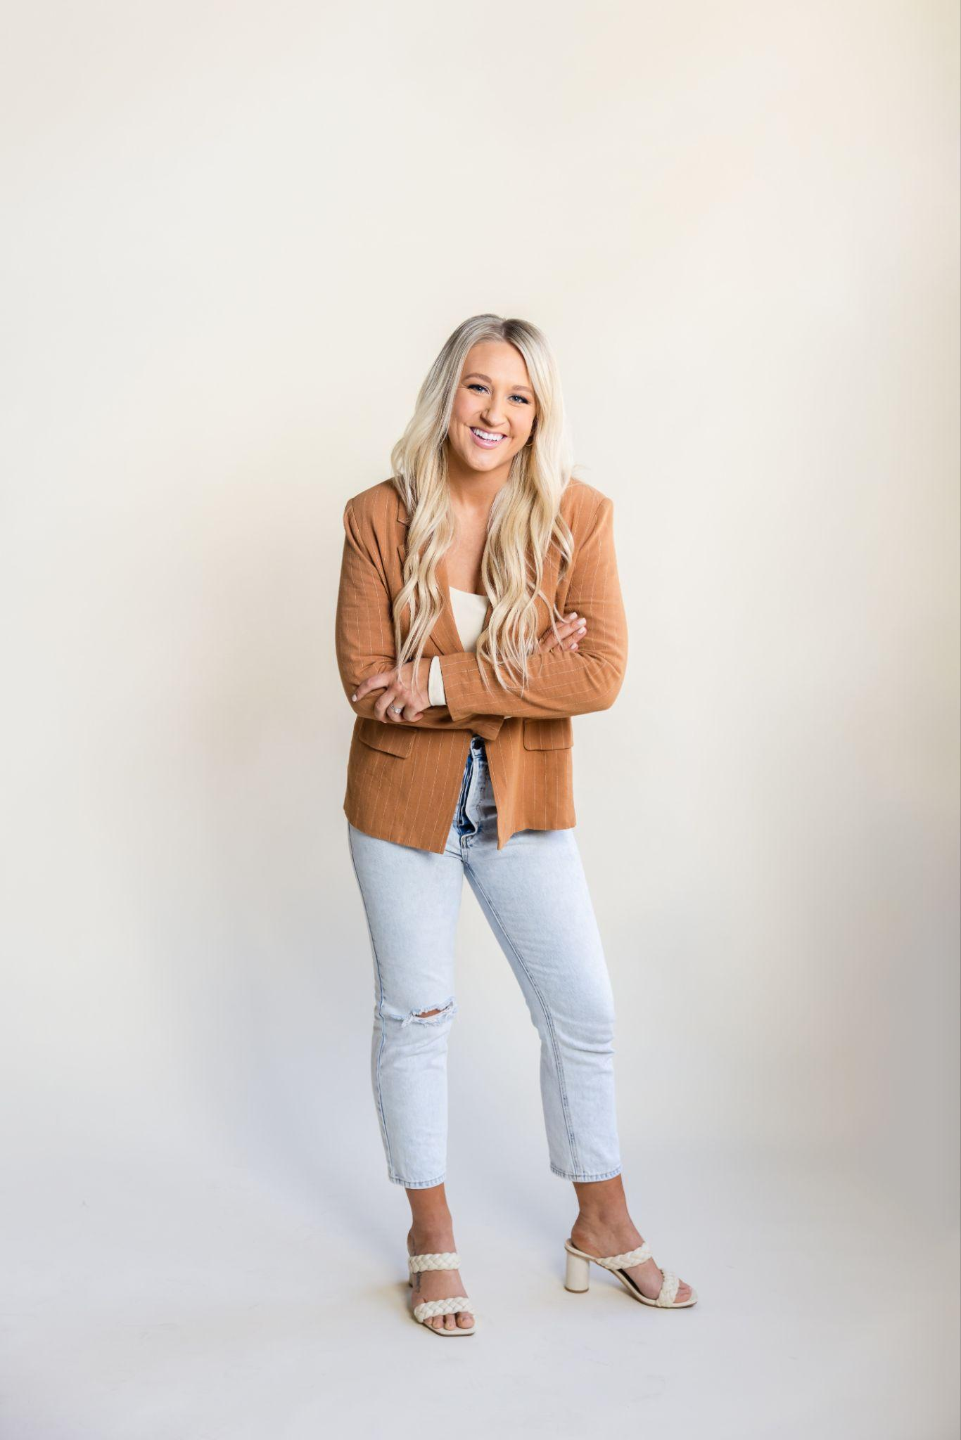
Idaho gal
Born and raised in Idaho Falls
Boise State alumni
BFA - Minored in Communications and Public Relations
Married to my best friend
New mama to my daughter Ryah
Sunshine & outdoors are my thing
Patios = love

Slide 3
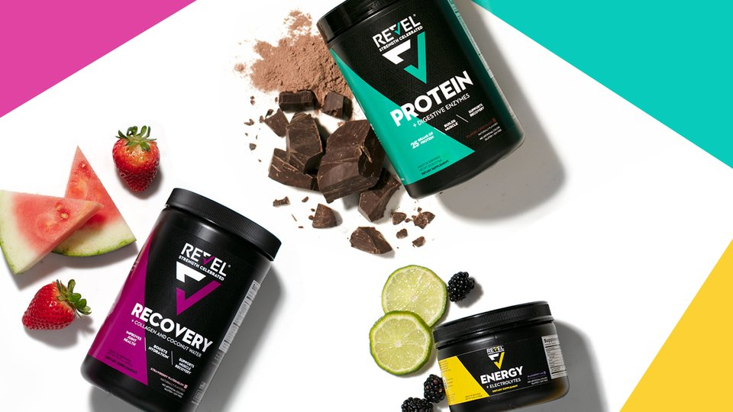
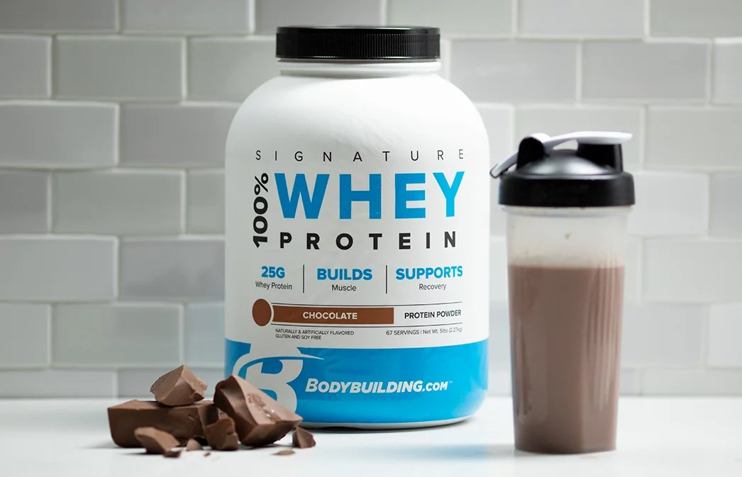
Building a Passion Brand

Slide 4
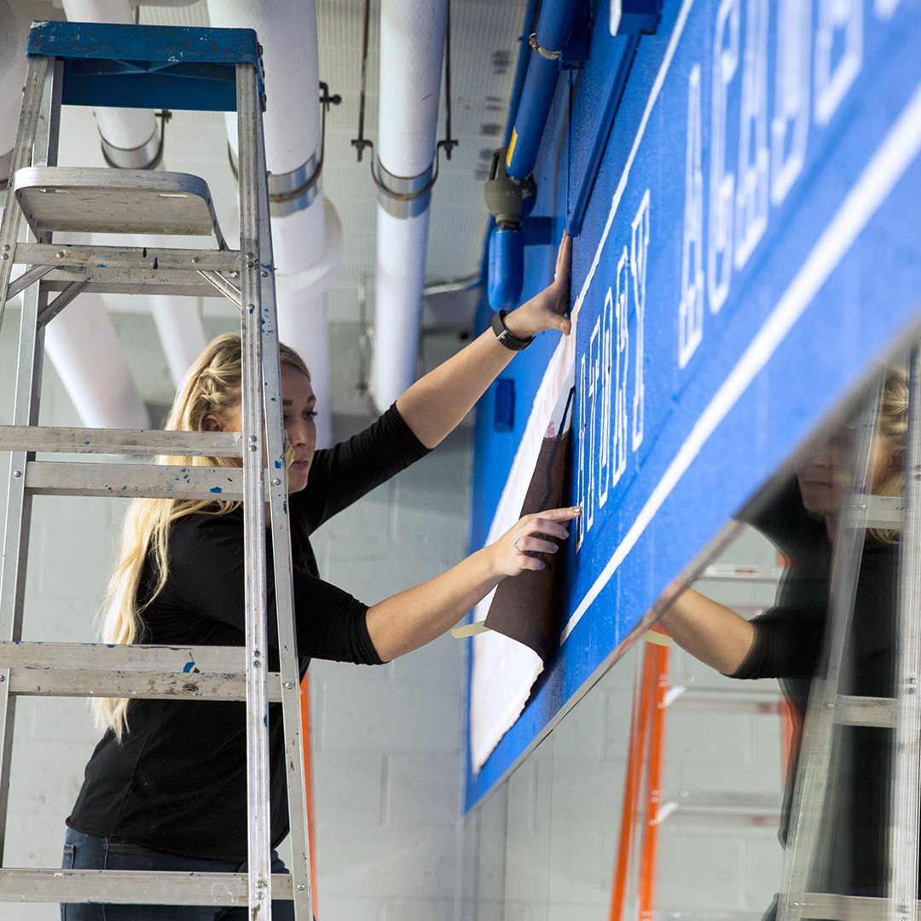
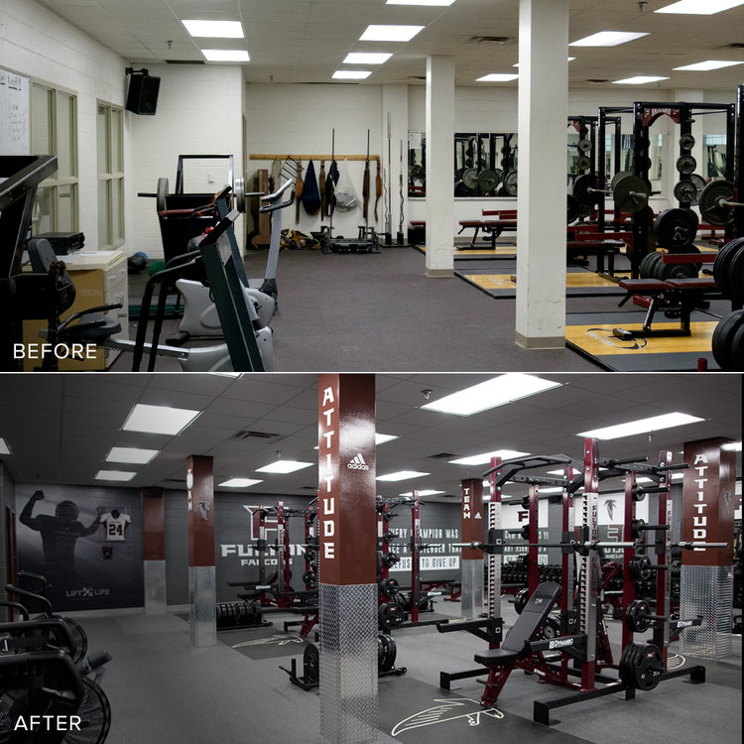
Building a Passion Brand

Slide 5
Building a Passion Brand

Slide 6
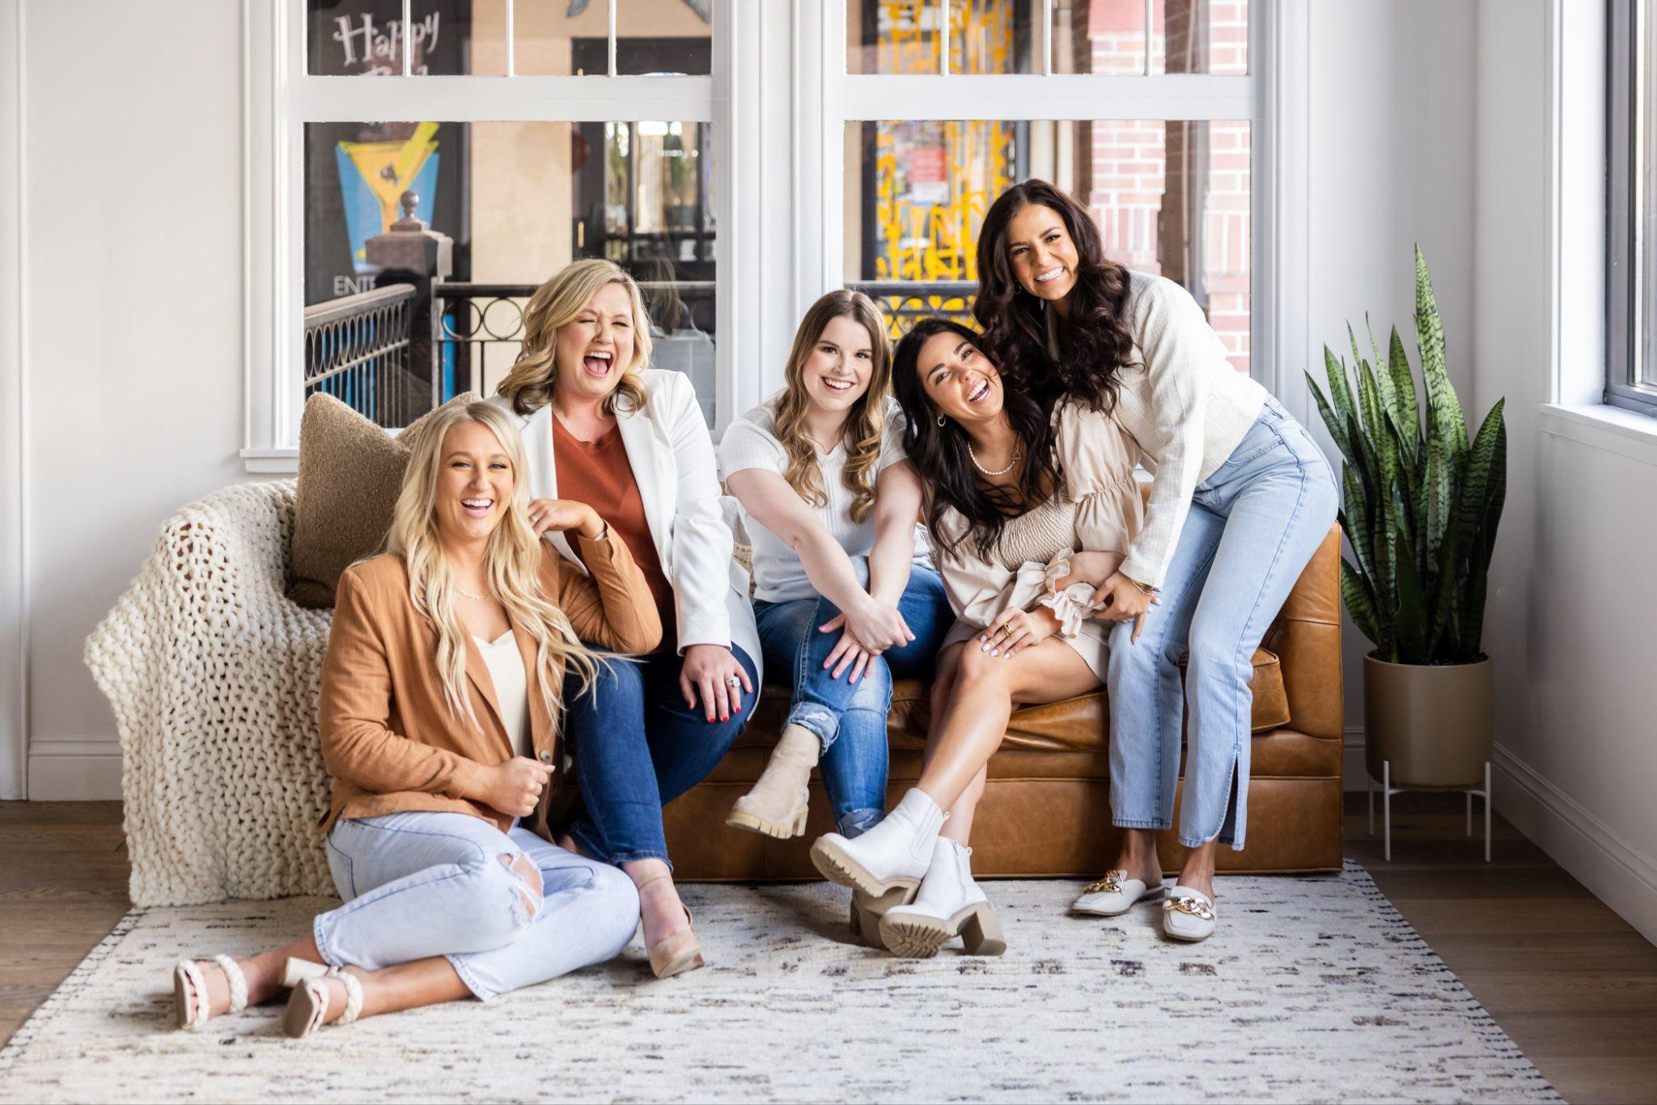
Building a Passion Brand
Notes:
Feminine - Approachable - Color Orange (Bold and Fun)
Explain the Name
There’s alot that goes into building a brand

Slide 7
BRAND POSITIONING
BRAND BUILDING
Market research
Competitor analysis
Value proposition
Brand positioning
Avatar analysis
Logos
Color scheme
Typography
Brand guidelines
Voice guidelines
+

Slide 8
=
PASSION BRAND
a passion brand is not a brand that consumers purchase purely out of habit — it's a brand they have an emotional connection with and want to be identified with by their peers.

Slide 9
BRAND LOYALTY
Brand loyalty with a company and/or its products turns
CUSTOMERS
INTO
ADVOCATES
When you create an emotional connection between
BRAND
&
CONSUMER
they become personally invested in your brand

Slide 10
HOW DO YOU GET THERE?
How do take your passion, your mission, and your why and allow your audience to feel that same passion?

Slide 11
IT’S NOT EASY.
The ability
to connect with
your audience
has changed.
The ability to discover brands has changed.
The landscape of competition has changed.
5X
Retaining customers is about
cheaper than recruiting new customers.
Notes:
Ask Question - shout out some passion brands out loud

Slide 12
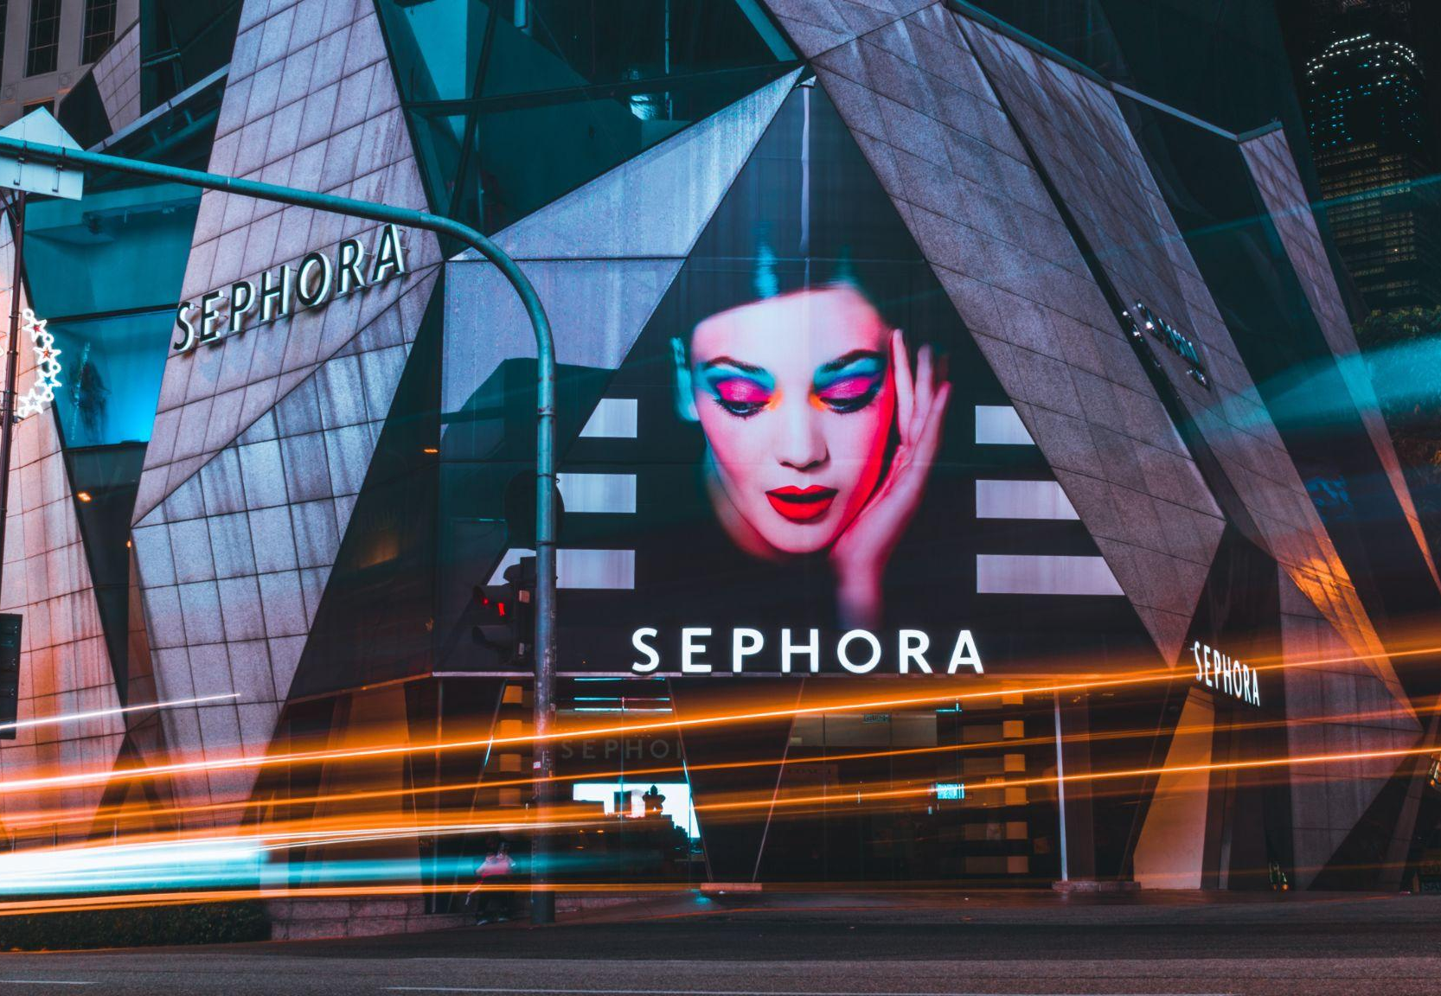
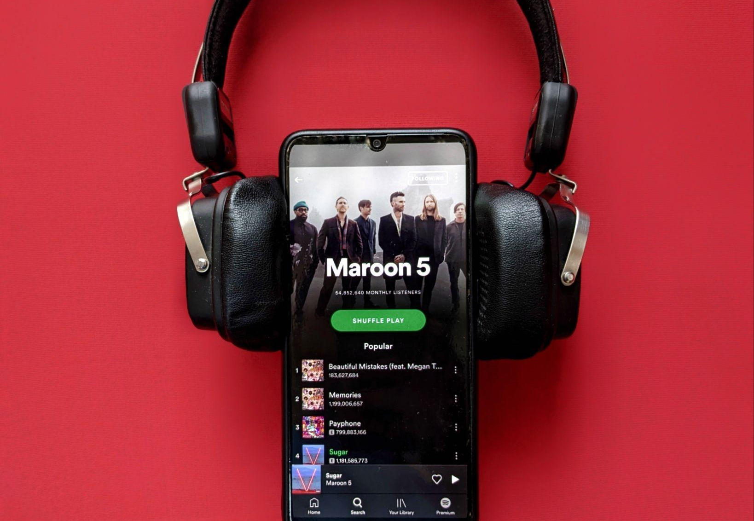
Repeat customers tend to spend more money on your brand than new customers because they trust your business.

Slide 13
CONSISTENCY?
Every industry is different
QUALITY?
as to why consumers choose one over the other
CUSTOMER SERVICE?
REWARDS?
Notes:
Starbucks - Lulu lemon - Chic fil a - Kohls Rewards
There are alot of reasons why someone may be loyal to a brand.
The cool thing about brand loyalty
is that the exact reason why someone may be loyal to say starbucks is the exact same reason why someone else may hate it. - Someone may be loyal to a local coffee shop because of its artisanal espresso bar and the luxury pastries and it's an intimate experience.
Not to say that someone who is loyal to starbucks doesn’t appreciate these things but it's not their top motivator.

Slide 14
TAKE HOME
EXERCISE
Pick a passion brand that you are loyal to and start brainstorming a list of all the reasons you are loyal to that brand.
Notes:
Have you ever sat down and truly thought about this?
Once you have your list, start rating your own business on these things. Could you be doing better?

Slide 15
Who do you want to attract
and what do they care about?

Slide 16
When you stand
behind what you offer
you will start to attract the right people and those people will become your brand loyalists.

Slide 17
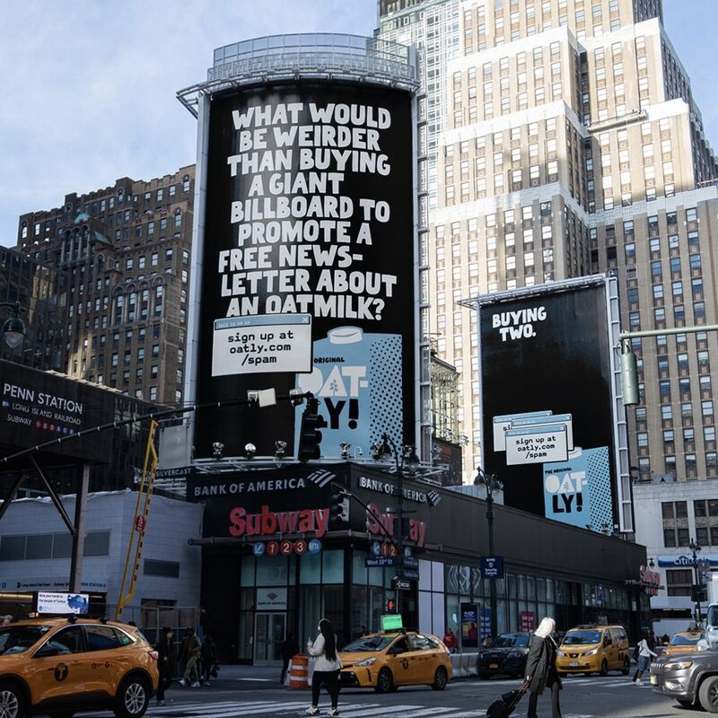
SHOW YOUR BRAND PERSONALITY
Who are you and what do you stand for?
This campaign wasn’t aiming for newsletter signups — they wanted conversations.
Aiming to be different in a category that is very much the same.
Notes:
Kevin lynch - Don’t fear being critizied - fear being ignored.
You really get their tone of voice when you read the second one.
Very tongue and cheek which makes the brand stand out amongst all the other competitors

Slide 18
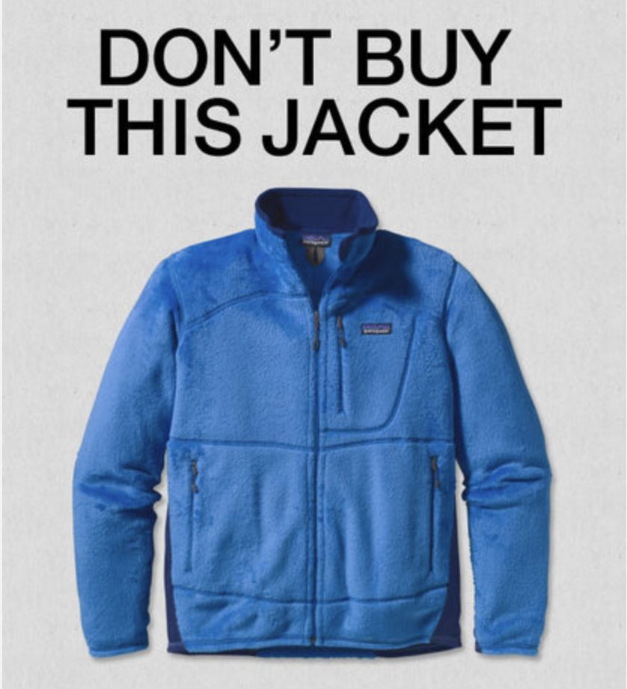
PLAY TO YOUR
STRENGTHS
& STANDARDS
Hone in on your core values
This campaign challenged customers to think before buying and encourages businesses to make fewer things but of higher quality.
The main goal was to prompt people to read the full article to take the common threads initiative pledge.
Notes:
Ran an ad in the new york times on black friday

Slide 19
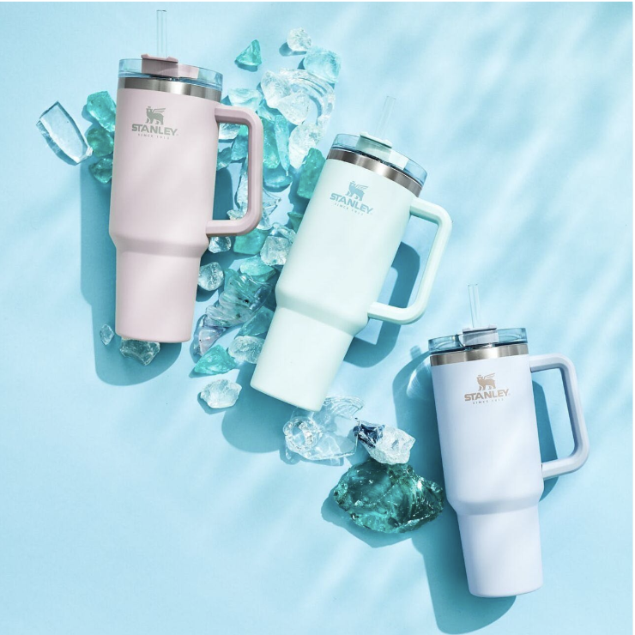
SHOW UP ON SOCIAL MEDIA
Consistency is key
1 in 3 people use social media to learn about or discover new products, services, or brands.
Blog brought the Stanley brand back to life.
Find your followers, then market to them.
Notes:
Marketing to men/camping gear
Cult like - buying into the community - Sales up 300% YOY.
Careful with trendy things.

Slide 20
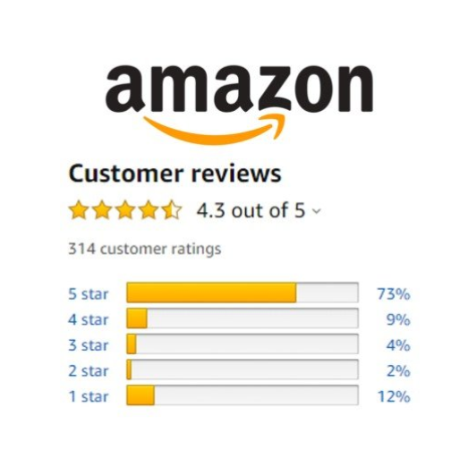
ENCOURAGE
CUSTOMER
FEEDBACK
Listen to the good and the bad
93% of users say online reviews had an impact on their buying decisions.
81% of consumers use Google to evaluate local businesses.
Consumers want to learn from other people’s experiences before trusting you enough to do the same.
Notes:
Build consumer trust by showcasing your current customers’ experience with your company.

Slide 21
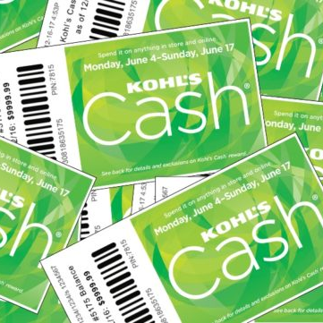
CREATE A
CUSTOMER
LOYALTY PROGRAM
Keep them coming back for more
80% of consumers say loyalty programs make them likely to continue business with a company.
When you offer your customers something they cannot get anywhere else, they will flock to you to receive the unique experience you offer.
Notes:
You can get creative with your offerings - Free drink, Or something special around the holidays, or refer a friend - Lots of programs out there

Slide 22
BE ADAPTABLE
Keep up with the times
DoorDash has 20 million monthly active users.
Now more than ever post-pandemic. People love convenience.
How can you save your customers time?
Notes:
Nowadays you can get in an uber in a foreign country

Slide 23
ONE LAST THING
Be kind to yourself and your business.
Notes:
Its so important for you to understand - there is alot of wins but there are also so many losses - Remember at the beginning when I was talking about all of the BBCOM wins. We had plenty of private label brands that never took off
Don’t beat yourself up if you aren’t a passion brand yet.
Take these small steps and always be reevaluating your brand to see things you can improve on.

Slide 24
THANK YOU
SO MUCH

